Slide 1

Aircraft Maintenance Prediction
CS610 Applied Machine Learning
G2 Group 10
Kimberly Bertoli
Do Thi Phuong Linh
Nguyen Kim Hau
Tanya Arora
Cheung See Lin
Notes:
See Lin

Slide 2

Business Problem
Problem Statement
There are broadly two types of aircraft maintenance:
Scheduled → Routine checks at fixed intervals
Unscheduled → Repairs triggered by unexpected failure of components.
Unscheduled maintenance events are costly both financially and operationally. Predicting when an aircraft is approaching such an event enables proactive interventions, minimizes inventory costs and flight delays, and improve engineering productivity.
End-to-End Solution
Data
Flight sensor recordings + maintenance logs
ML Model
Predict maintenance risk
Decision Making
Planners inspect, stage parts, schedule
Deployment
Risk flags integrated into maintenance planning
Expected Downstream Business Impact
Cost Reduction
Avoid premium emergency-repair costs
Risk Mitigation
Catch degradation before failure
Process Efficiency
Smarter scheduling cuts unplanned downtime
Revenue Protection
Fewer groundings means higher aircraft availability
Notes:
Aircraft on ground (AOG) is used to describe that an aircraft is unworthy of flight. Maintenance is typically the main cause for grounding of an aircraft, from which it can be split into two sections.
Scheduled maintenance is when planned preventive maintenance is schedule to be carried out typically the replacement of consumables, or spare parts.
Unscheduled maintenance is when components fail unexpectedly, and requires replacement or repair.
Predictive maintenance attempts to solve this by SURPRISE, predicting when maintenance is required, and preparing the required spare parts, as well as scheduling a maintenance check to prevent any unforeseen events. This can range from a Just-In-Time supply chain, to targeted maintenance routine, so as to reduce escapes.
The study utilizes flight sensor data, pass it through various ML models, flags out potential maintenance requirements, and finally provide insights for key stakeholders to make decisions in order to minimize AOG situations.
--------
Unscheduled maintenance can be costly both financially and operationally. If the issue is not resolved, such as spare parts are not available, the aircraft may be grounded indefinitely. There is also a risk of both lives and property when required maintenance is not carried out.
Predictive maintenance attempts to solve this by surprise, predicting when maintenance is required, and preparing the required spare parts, as well as scheduling a maintenance check to prevent any unforeseen events. This can range from a Just-In-Time supply chain, to targeted maintenance routine, so as to reduce escapes.
The study utilizes flight sensor data, pass it through various ML models, flags out potential maintenance requirements, and finally provide insights for key stakeholders to make decisions in order to minimize AOG situations.
The plane for evaluation will be the Cessna 172, which is a single engine fixed wing aircraft, which will be used to test the viability of this approach.

Slide 3
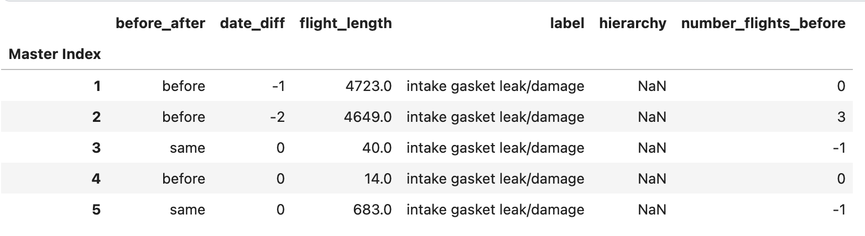
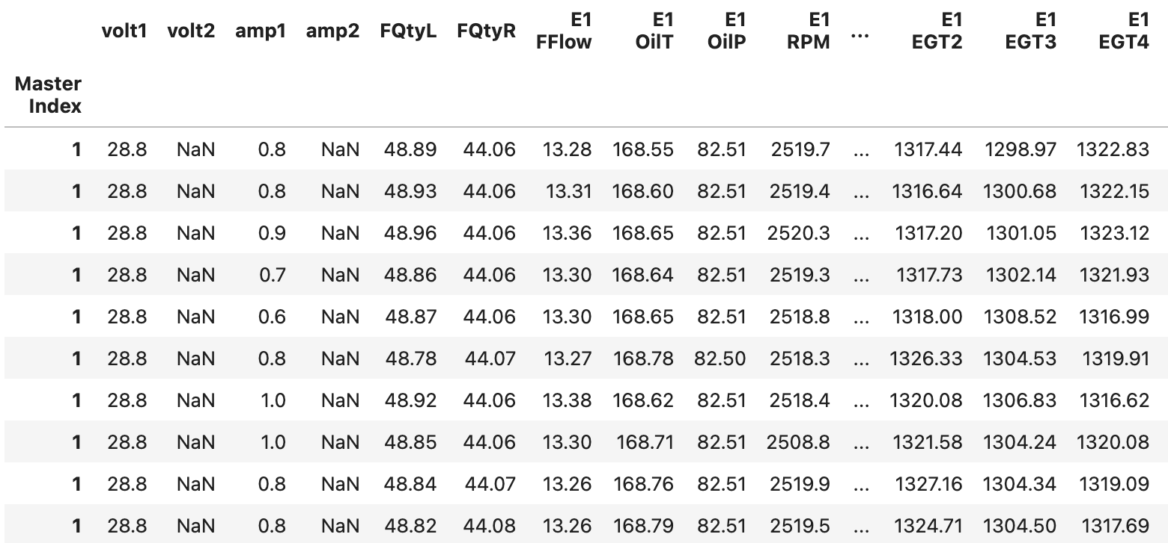
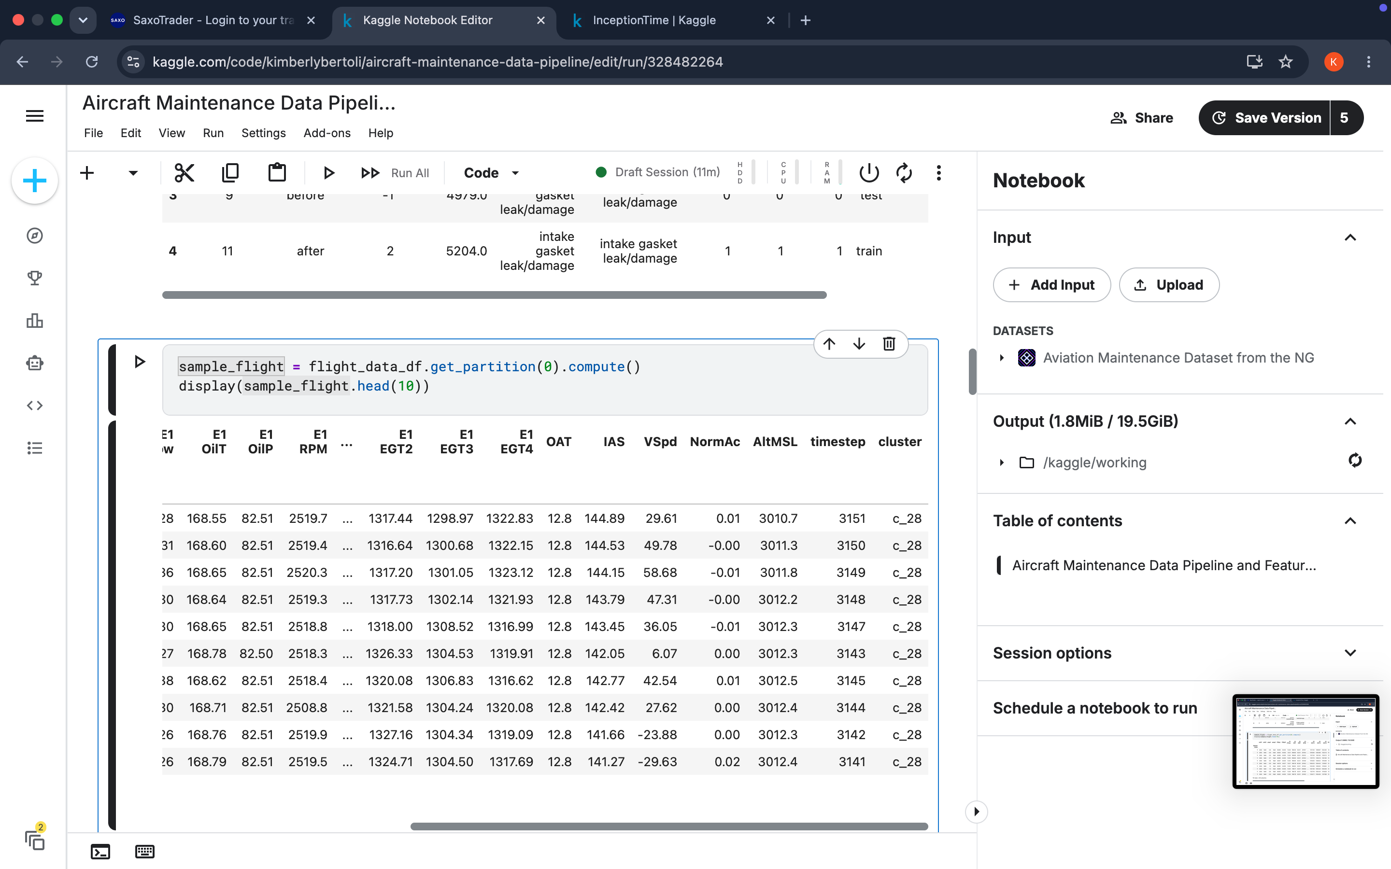
Dataset
About the Dataset:
This dataset uses flight records and unplanned maintenance logs from a Cessna 172 aircraft, sourced from the National General Aviation Flight Information Database (NGAFID).
29k
flights
X
4,400
Median timesteps per flight
Multivariate time series of sensor/flight ⇒ 113 million records
Flight Metadata (raw header)
=
Each flight records information from 23 sensors every second. We know each flight’s position relative to maintenance in terms of timing, order, and whether it occurs before or after the event.
Sensor Data
Column Name | Description
Master Index | Primary Key to link to the flight records
Before After | Whether or not a flight occurred before or after maintenance. Some flights occurred during maintenance (generally test flights)
Date Diff | Days before or after the maintenance period
Flight Length | Number of flight recordings for the whole flight (duration of flight in seconds)
Label | Maintenance Issue
Hierarchy | Maintenance Issue Hierarchy, if NaN then Other.
Number of Flights Before | The Nth flight before maintenance, with 0 representing the flight immediately before and -1 representing not applicable.
Dataset: https://www.kaggle.com/datasets/hooong/aviation-maintenance-dataset-from-the-ngafid
Notes:
We can now look into the dataset, which uses flight records from the National General Aviation Flight Information Database in the US. It logs unplanned maintenance logs from a Cessna 172 aircraft.
The total dataset consist of ~29k flights, with a median timestep of ~4400 per flight forming a multivariate time series for each flight.
In total, we have more than 100million lines of sensor data recording consolidated into 2 data sources:
Time series of sensor data for each flight index
Flight meta data for each flight index.

Slide 4
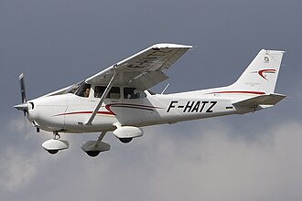
Field Description
Field | Description
volt1 | Main electrical system bus voltage (alternators and main battery)
volt2 | Essential bus (standby battery) bus voltage
amp1 | Ammeter on the main battery (+ charging, - discharging)
amp2 | Ammeter on the standby battery (+ charging, - discharging)
FQtyL | Fuel quantity left
FQtyR | Fuel quantity right
E1 FFlow | Engine fuel flow rate
E1 OilT | Engine oil temperature
E1 OilP | Engine oil pressure
E1 RPM | Engine rotations per minute
E1 CHT1 | 1st cylinder head temperature
E1 CHT2 | 2nd cylinder head temperature
E1 CHT3 | 3rd cylinder head temperature
E1 CHT4 | 4th cylinder head temperature
E1 EGT1 | 1st Exhaust gas temperature
E1 EGT2 | 2nd Exhaust gas temperature
E1 EGT3 | 3rd Exhaust gas temperature
E1 EGT4 | 4th Exhaust gas temperature
OAT | Outside air temperature
IAS | Indicated air speed
VSpd | Vertical speed
NormAc | Normal acceleration
AltMSL | Altitude miles above sea level
Timestep | Timestep value for the flight
Field | Description
Master Index | Flight Index
before_after | Record before / after maintenance
date_diff | Record log number of days before / after maintenance.
flight_length | Number of timestep (s)
label | Type of Maintenance Done
hierarchy | Class of Maintenance Required
Source: https://en.wikipedia.org/wiki/Cessna_172
Notes:
The time series of sensor data consist of fields such as:
Engine monitoring and performance
electrical system voltage,
current draw,
Fuel level
Oil temperature
RPM, etc.
And various temperature sensors around from cylinder head, exhaust gas.
It also includes environment variables such as:
Outside temperature
Air speed
And finally flight details:
Vertical speed, acceleration, as well as altitude.
The flight metadata includes:
Record type before or after maintenance
Number of days
Flight length
Type of maintenance
Class of maintenance
For example, label can be engine need repair/reinstall/clean, and the hierarchy can be engine

Slide 5


ML Problem Formulation and Solution
Objective: Predict whether an aircraft will require unscheduled maintenance within a specified future horizon (2 days) using flight sensor and operational data.
2-Day RUL was chosen as it captures aircraft requiring immediate maintenance attention, providing a more actionable risk definition. Longer horizons (5 and 10-day) exist for sensitivity and generate earlier warnings but may introduce more false positives and dilute the distinction between urgent and non-urgent maintenance cases.
Input Features (X)
Flight sensor data multivariate
Binary
Classification
Target Output (Y)
0 = Risk
1 = Safe
RUL= 1 (SAFE): flight is after maintenance OR before but > 2 days away
RUL = 0 (RISK): flight is before AND within 2 days of maintenance
Evaluation Metrics:
Recall
Precision
F-1 Score
ROC-AUC
PR-AUC
Confusion Matrix (Error Analysis)
XGBoost
Tabular aggregate
features
Soft Voting
Baseline
MiniRocket
Best Model Selected
Ensemble
Stacking
Inception Time
Highest AUC-ROC
Cost Trade-Off:
False Negative (Missed Alert)
Cost: VERY HIGH
False Positive (False Alarm)
Cost: MODERATE
Deep Networks
Transformer
Both implemented; tiebreak on class-0 recall.
Ensemble adopted if it beats best single model.
Notes:
Kim

Slide 6
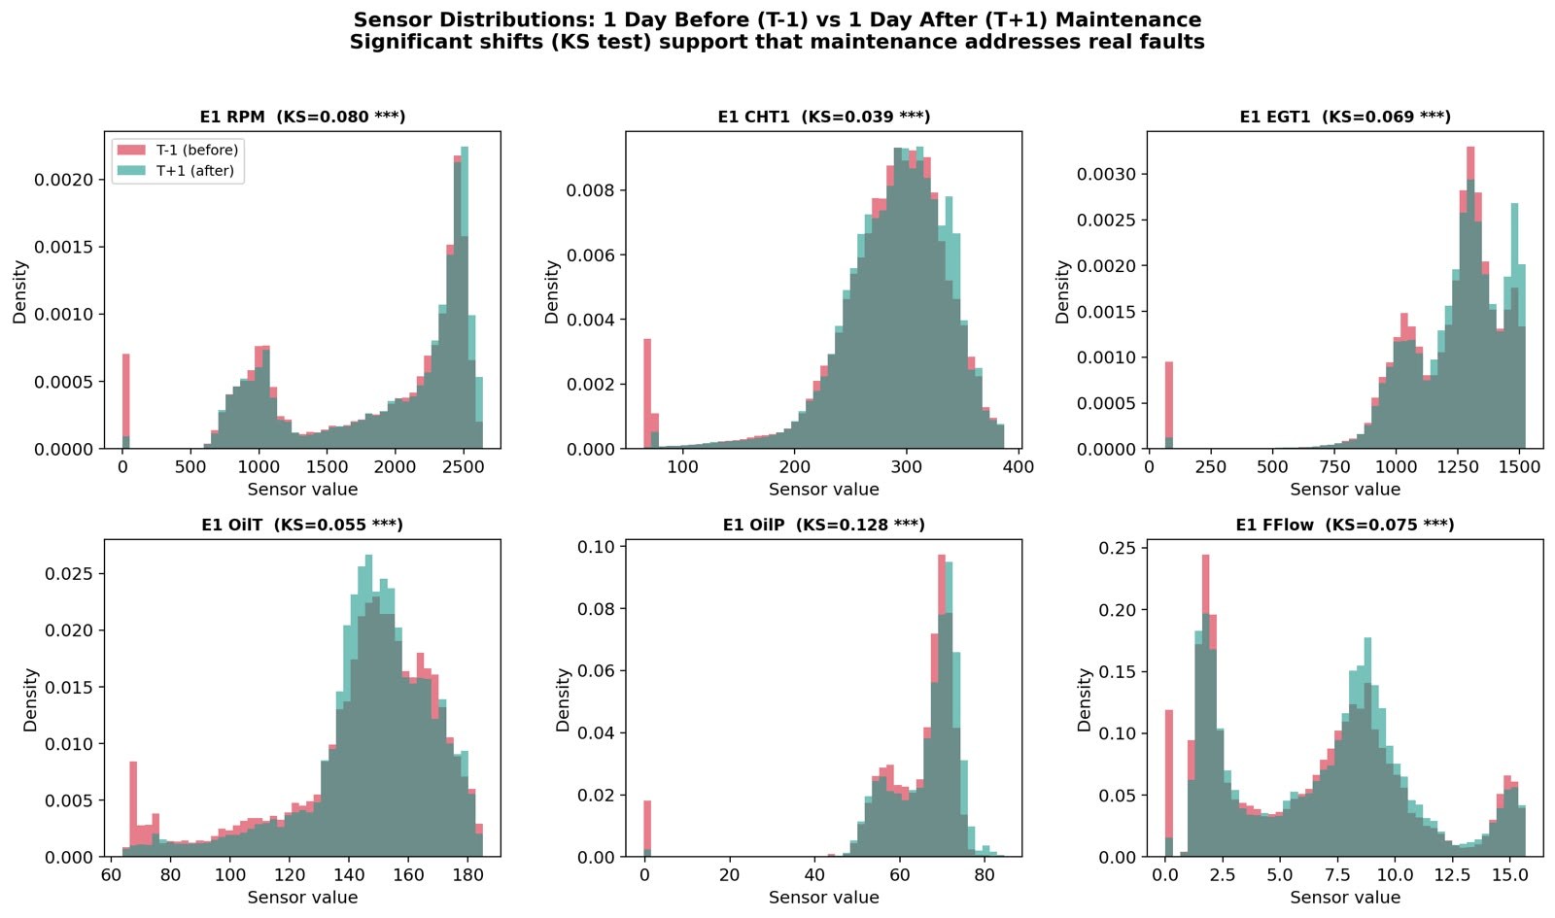
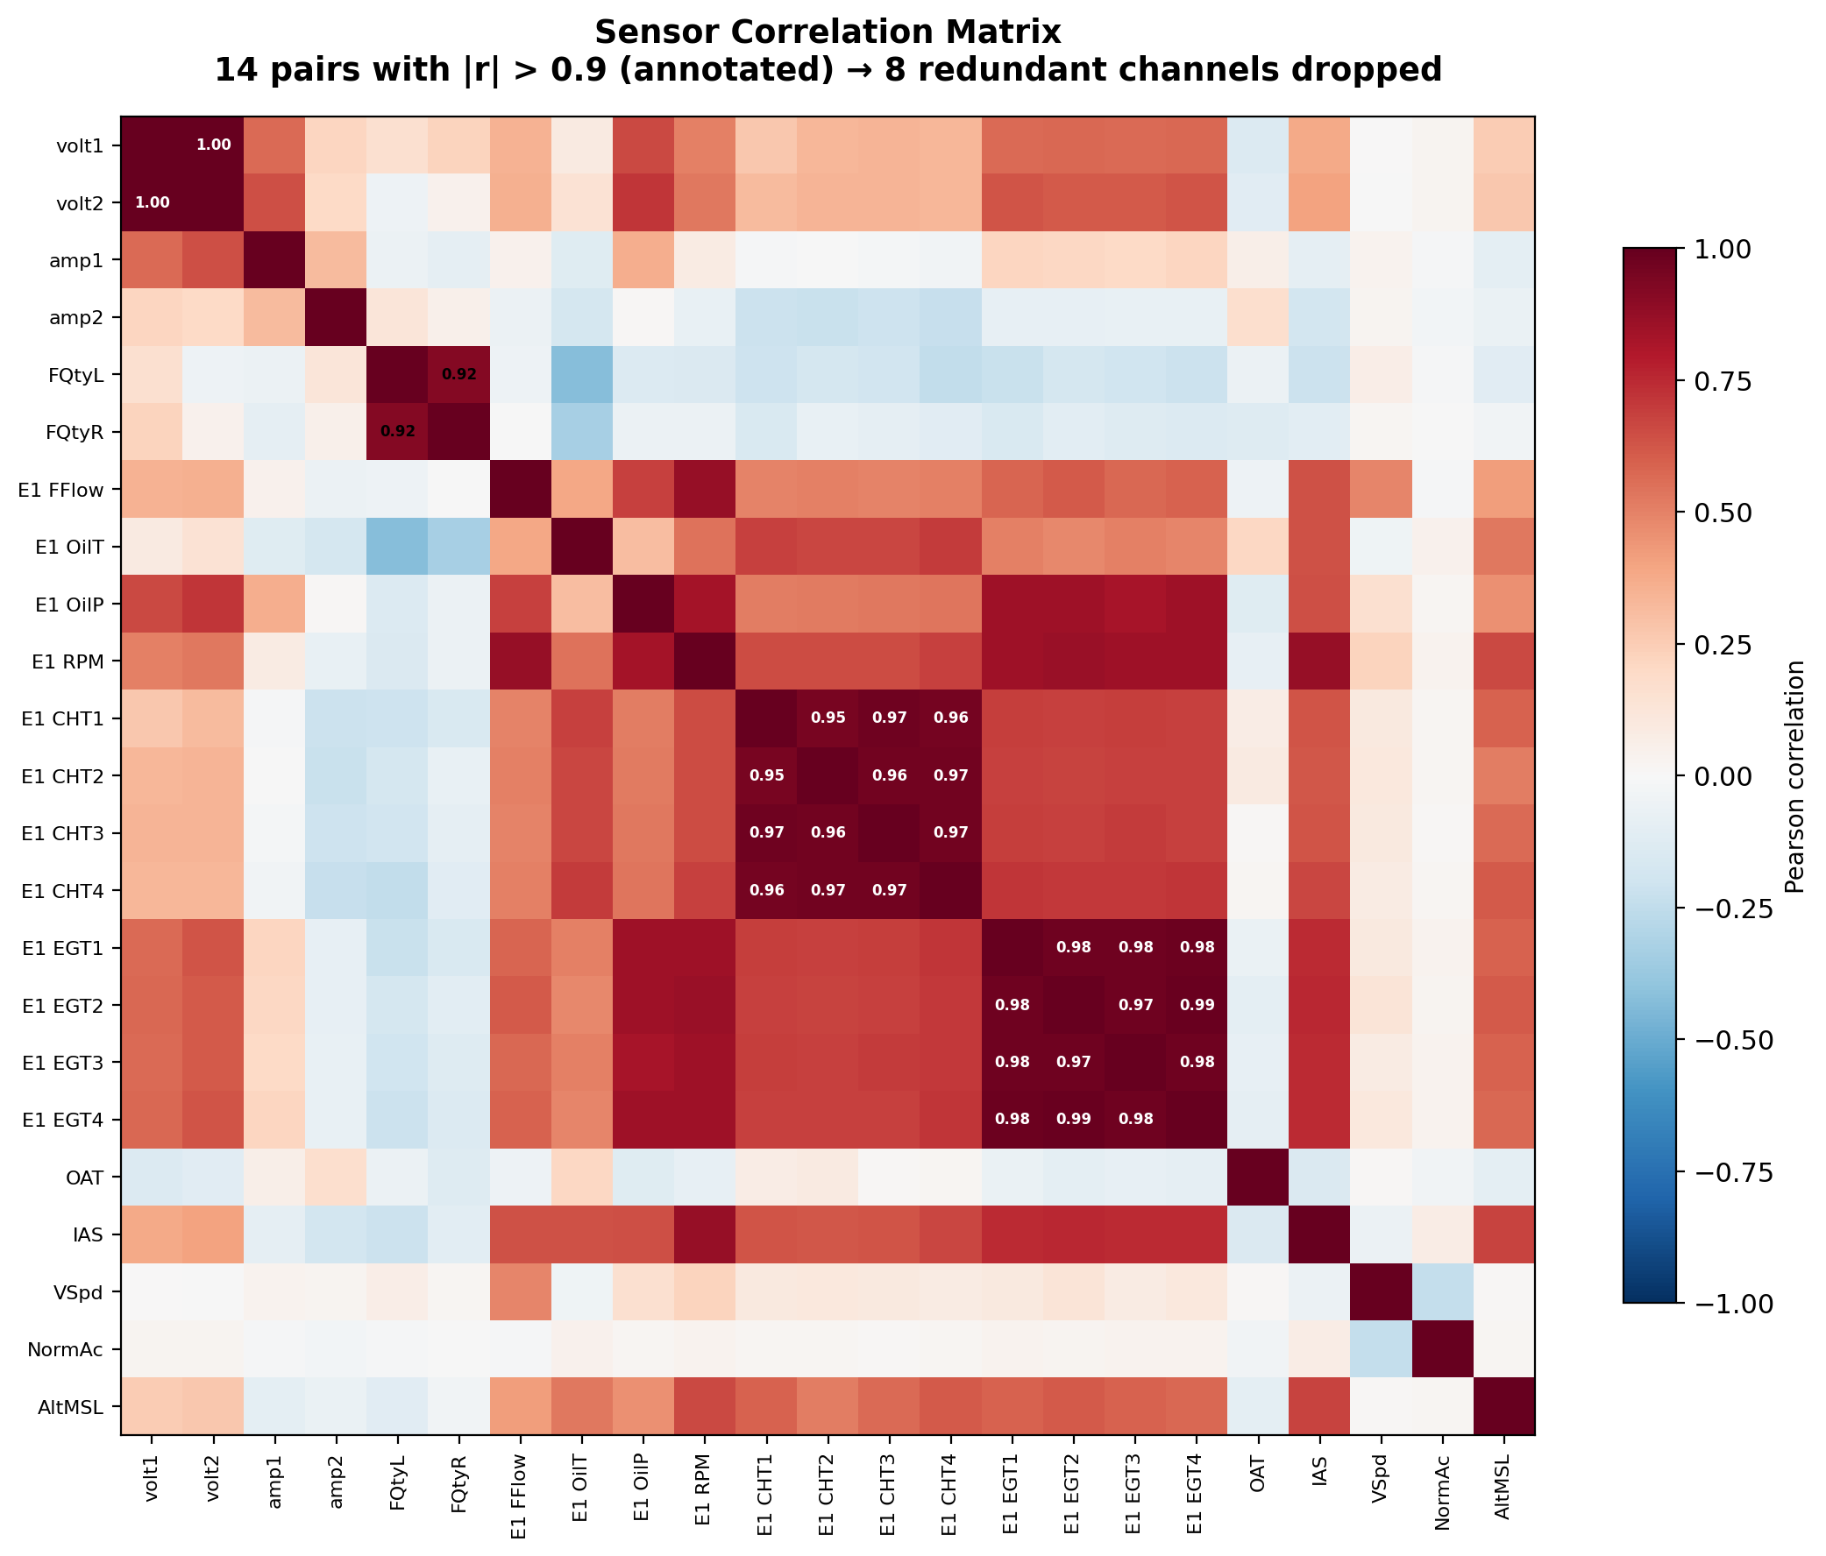
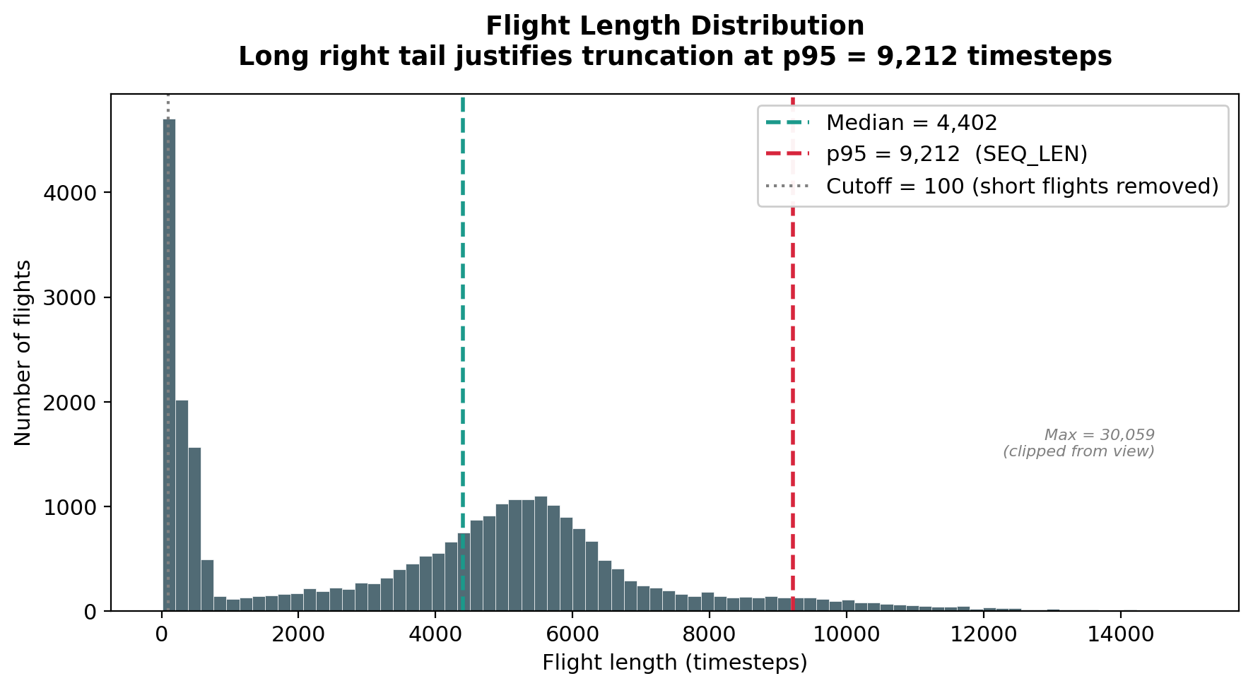
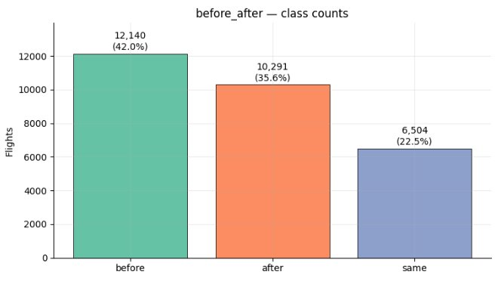
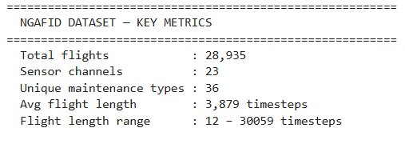
EDA
(15 retained after dropping redundant ones)
Notes:
Kim

Slide 7
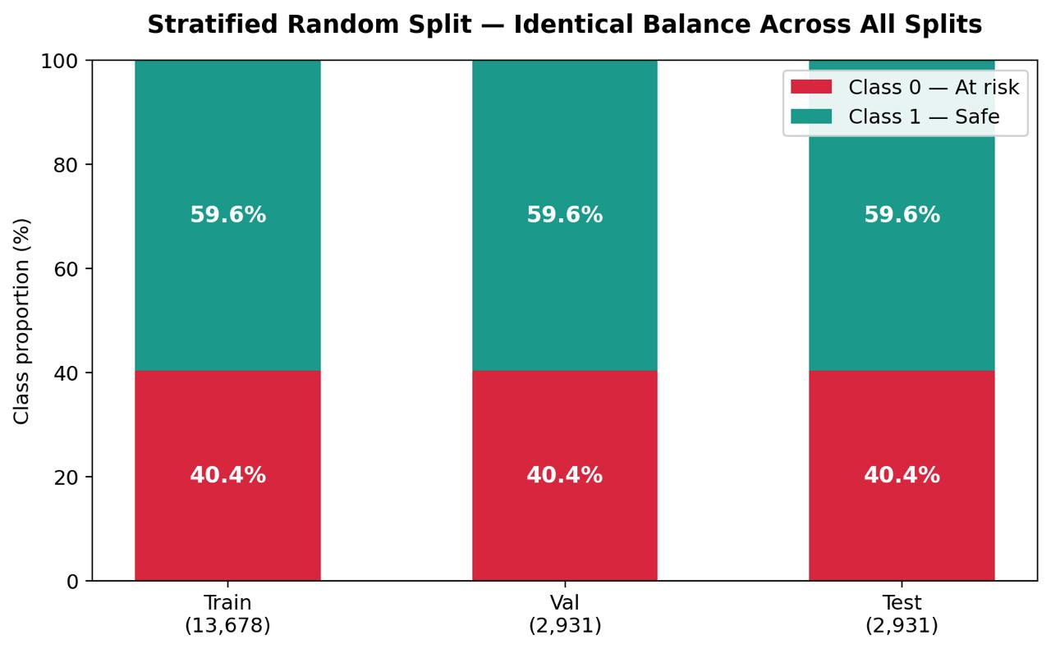
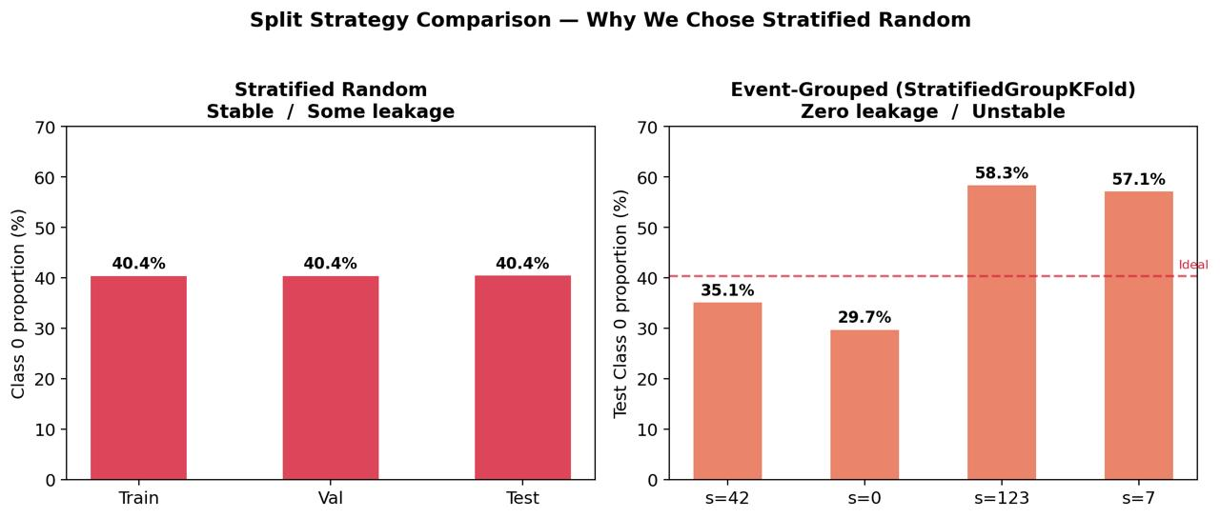
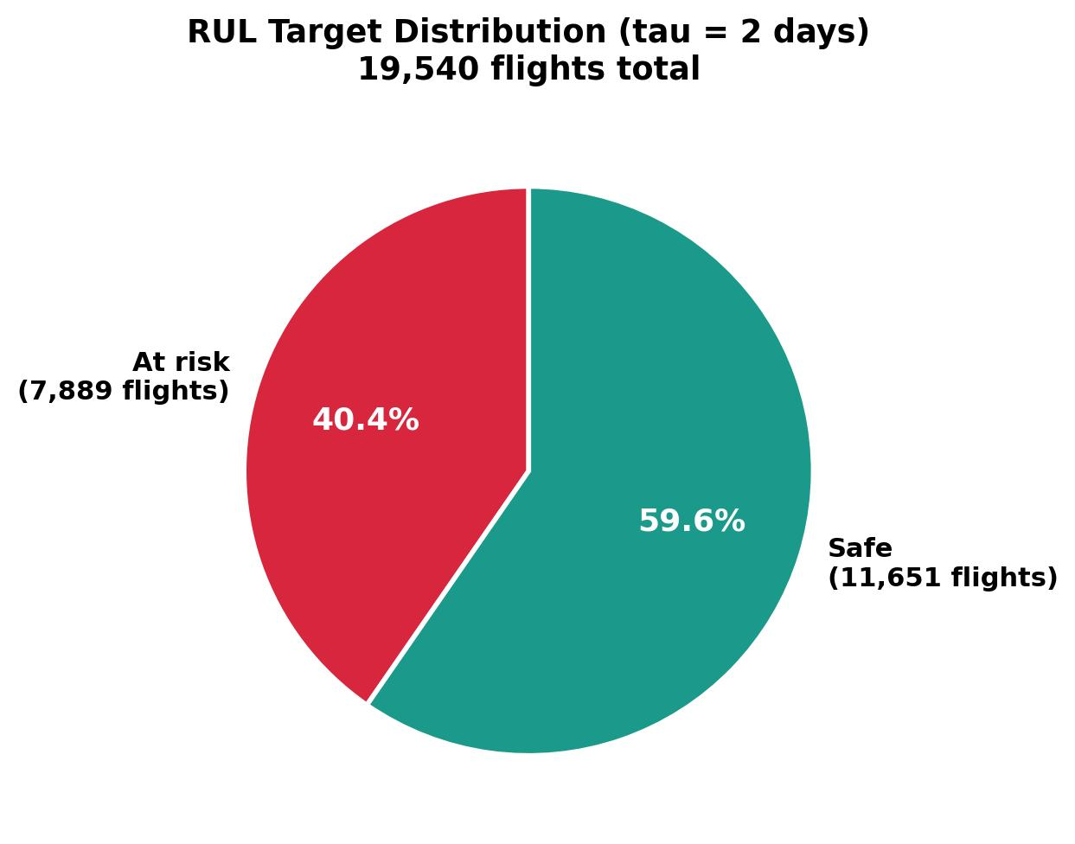
Data Preprocessing
1
2
3
4
5
Data Cleaning
Target Engineering
Train/Val/ Test
Sensor Selection
Tabular Feature Engineering
flight_length < 100 removed
Flights where before_after == "same" removed
0 (Risk) if the aircraft is within 2 days of a maintenance event, else 1 (Safe)
Stratified Random Split: Train (70%), Val (15%) and Test (15%)
Highly correlated sensors (>0.9) dropped. Out of 23 retained 15 sensors
Statistical, Trends, by flight phase, domain specific (fuel efficiency, imbalance etc.)
Stratified Random Split maintains a consistent Class 0 ratio (~40.4%) across all seeds, ensuring stable and comparable evaluations. Grouped Event Split exhibits substantial fluctuations (30–58%), leading to higher evaluation variance and less reliable model comparisons.
8
Time-Series Sequence Construction
7
Missing Values
6
Scaling
Fixed Length tensor of shape (9212,15) where 9212 is 95th percentile length
Forward fill, Backward fill and Zero fill to preserve temporal continuity
RobustScaler fitted on raw sensor sequences, tabular features
Notes:
Kim

Slide 8
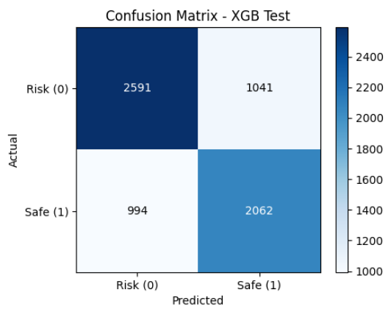
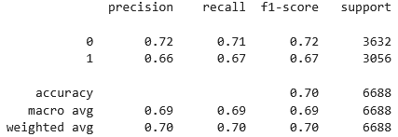
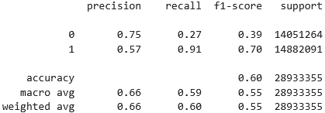
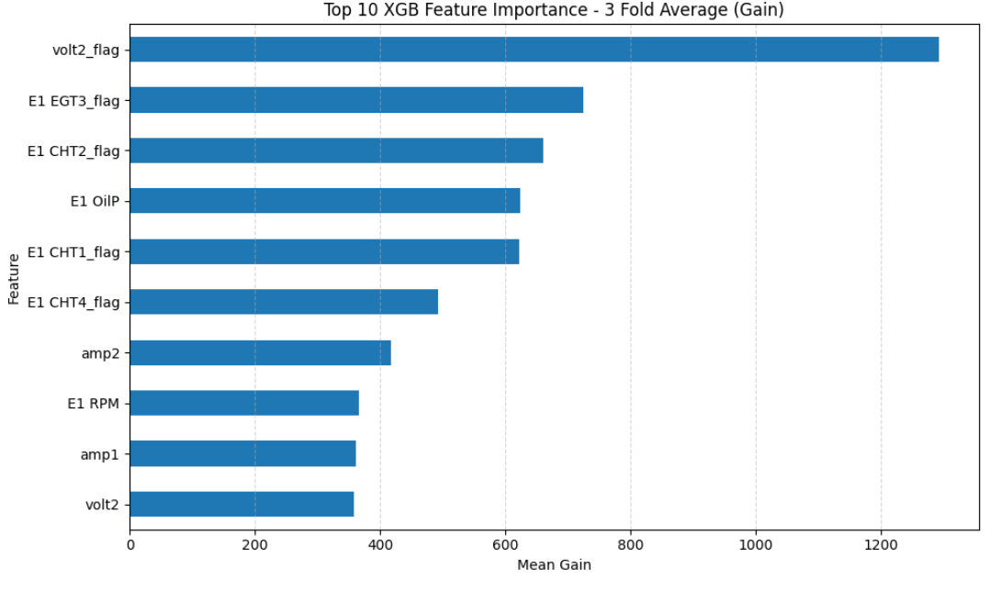
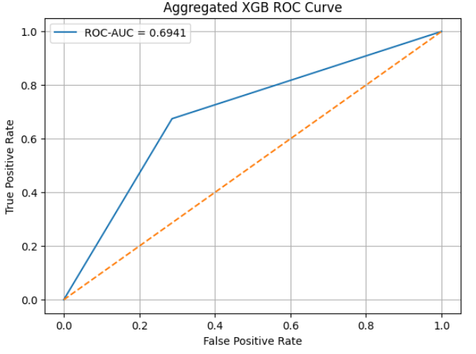
XGBoost Approach and Results
Feature preparation
From the dataset, additional features were created
Create missing flags per sensor
Fill all missing values 0
Take the difference between each timestep and the previous
Classification Report
~ 16 % increase in prediction accuracy from aggregation
Aggregated
Setup
Group K=3 folds for XGB classifier, on training data, parameters optimized with Optuna
Results then aggregated per flight
Raw
Individual cluster points
Results
Flags have strong feature importance: Missing sensor data is indicator of requiring maintenance
Aggregated Data has a ~ 70% accuracy vs Raw: Not all data points within a flight are problematic points
Conclusion
Able to sufficiently predict
Costly to train ~ millions of rows
Utilizing transformer steps may be necessary
Notes:
We first look at a base XGBoost approach and the associated results.
Additional features were first created, which were creating a missing flag column per sensor, imputing the original value with 0, and then creating a column where the we calculated difference between each timestep x – (x-1).
Group k=3 folds were then run, and parameters were optimized with Optuna, and the results were then aggregated for each flight.
Investigation of the results show that the flags have strong feature importance, which implies missing data or faulty sensors is indicative of requiring maintenance.
When comparing the difference between aggregated vs non aggregated data, we see a more than 10% increase in accuracy prediction, up from 60% to 70%. This is due to while a flight is flagged as maintenance, not all data point within are problematic.
In summary, the base XGBoost approach is able to reasonably predict the necessity for maintenance. The drawback is that training of millions of rows is computationally expensive, and utilization of transformer steps may be necessary in order to streamline the training process.
Without feature preparation, accuracy ~ 50%, close to coin flip.

Slide 9
MiniRocket
MINI
RO
C
KE
T
Minimally
Random
Convolutional
Kernel
Transform
Why MiniRocket: Time-series classification models are often computationally intensive and slow to train. MiniRocket provides a fast, deterministic, and highly efficient feature transformation approach, significantly reducing training time.
MINI
Repeat for Many Kernels and Dilations
Input Time Series
Convolution
Feature Map
PPV Pooling
Feature Vector
Linear Classifier
1D Kernel (length 9) dilation d
Kernel slides across sequence
PPV converts each feature map to one number by taking fraction of positive values
Ridge/ Logistic regression
Approach
MiniRocket is deterministic and minimally random
Kernel | Fixed set of 84 kernels
Weights | {-1,2}
Dilation | Fixed (rel. to input length) Powers of 2
Padding | Fixed
# of features (default) | ~10k
Input Time Series
Shape: (19540, 9212, 15)
Best Model
Recall>F1>Precision
Calibrate for comparison
MiniRocketMultivariate()
fitted to get features
Shape: (N, 9996)
Ridge Classifier
alpha=1210, class_weight=“balanced”
Concatenate tabular features
Shape: (N, 10293)
Scaling
StandardScalar()
Logistic Regression
C=0.005, class_weight=“balanced”
Dilation creates gaps in kernel which increase receptive field and helps identify short and long patterns
*Hyperparameters were tuned of each classifier using Optuna no. of trials = 20
Notes:
T
3 positions in kernel are +ve, 6 are –ve so 9C3 The 84 kernels come from choosing 3 positive positions out of 9, i.e. $\left({9 \atop 3}\right)=84$, while the remaining positions are implicitly negative.

Slide 10
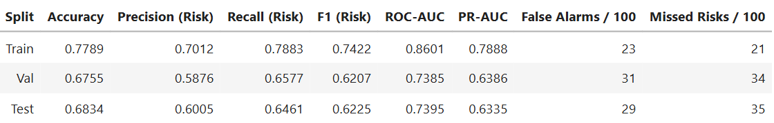
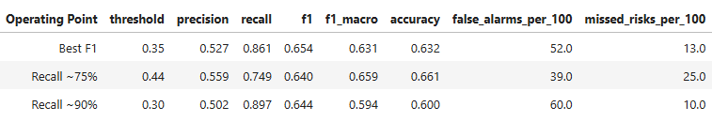
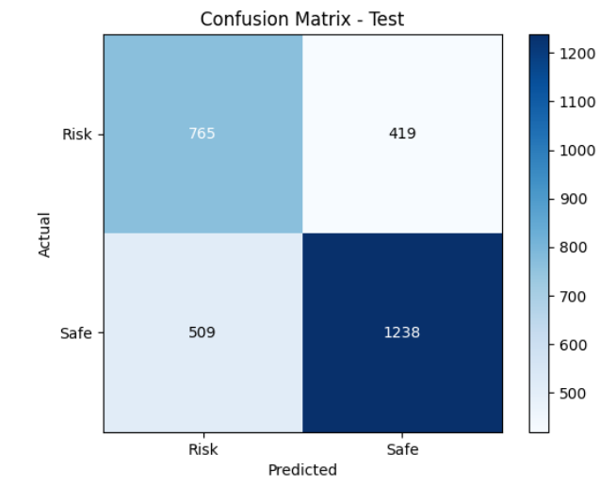
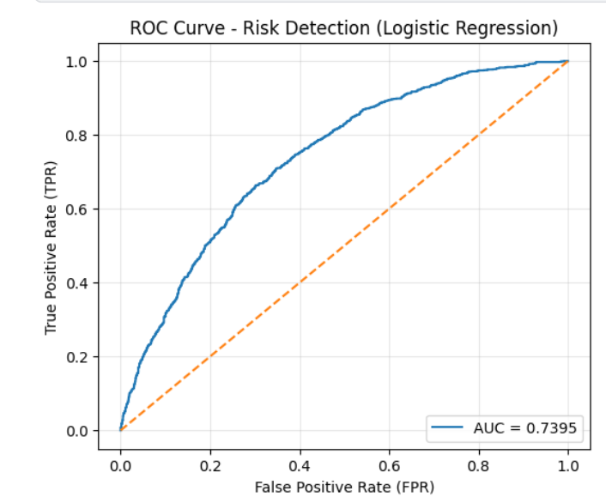
MiniRocket Results
Ridge vs Logistic Regression
Model Choice: Logistic Regression
Logistic Regression beats Ridge in all aspects except precision. Prioritizing recall of risk class, we choose Logistic because in a risk-sensitive setting catching true positives is more important than false alarms. It also achieves higher F1 and ROC-AUC, indicating better trade-off.
Logistic Regression Evaluation
Threshold Sweep Analysis
Key Insights
The model generalizes well with only a small drop from train to validation/test performance, indicating mild overfitting
On the test set, PR-AUC is 0.6335, indicating a moderate ability to balance precision and recall under class imbalance.
On the test set, model correct identifies 765 risk flags but misses 419, while producing 509 false alarms.
Moving from Best-F1 to Recall-90% cuts missed risks from 35 to 10 per 100 flights, trading off more false alarms (29 to 60)
ROC-AUC 0.74 tops the XGBoost baseline (0.69)
*Model choice was made based on validation data
Notes:
T

Slide 11
Inception
Notes:
Linh

Slide 12
Inception Approach and Results

Slide 13
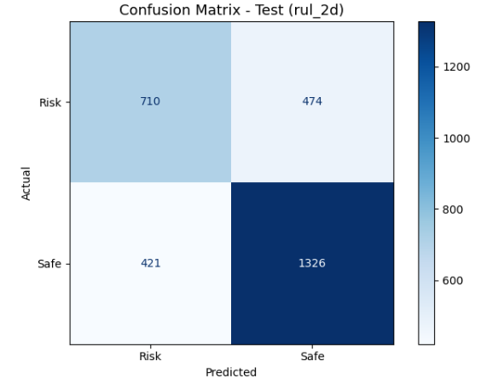
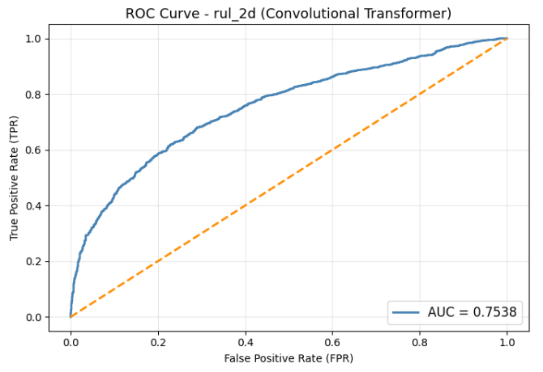
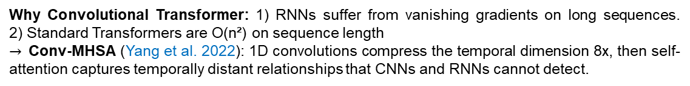
Transformer
Why Convolutional Transformer: 1) RNNs suffer from vanishing gradients on long sequences. 2) Standard Transformers are O(n²) on sequence length
$→$Conv-MHSA (Yang et al. 2022): 1D convolutions compress the temporal dimension 8x, then self-attention captures temporally distant relationships that CNNs and RNNs cannot detect.
Architecture
Result
Model Evaluation
Input time series
Shape (19540, 9212, 15)
Split | Accuracy | Precision | Recall | F1 | ROC-AUC | PR-AUC
Val | 0.7015 | 0.6421 | 0.5799 | 0.6843 | 0.7590 | 0.8210
Test | 0.6970 | 0.6280 | 0.5990 | 0.6790 | 0.7538 | 0.8163
710
474
Conv1d (stride=2 → stride=4)
9212 → 1152 timesteps (8x compression)
Threshold sweep analysis
Operating point | Threshold | Accuracy | Precision | Recall | F1
Best F1 | 0.17 | 0.70 | 0.63 | 0.63 | 0.69
Recall 75% | 0.03 | 0.68 | 0.58 | 0.76 | 0.68
Recall 90% | 0.02 | 0.63 | 0.53 | 0.89 | 0.63
421
1326
Positional encoding
Learnable, adds temporal order
Key Insights
4x Transformer encoder
8 heads, d_model=256, dim_ff=1024
PR-AUC 0.816: strong ranking ability, reliably scoring at-risk flights higher than safe flights across all thresholds.
PR-AUC val vs. test gap < 1%: minimal overfitting.
At 90% recall point: catching nearly all failures is worth the extra inspections.
Optimal threshold is 0.17 rather than default 0.50: threshold optimization is a required step before deployment.
Masked mean pooling
Ignores zero-padded timesteps
Linear(256, 2)
Output: P(at-risk), P(safe)
Optuna: 500 flights (20 epo) + 2,000 flights (12 epo). Warm-start + Locked parameters + HyperbandPruner

Slide 14
Transformer Approach and Results

Slide 15
Ensemble Model Approach and Results
Notes:
Helen

Slide 16
Summary
Notes:
T

Slide 17
Limitations, Deployment and Future Scope
Limitations
Deployment
Future Scope
1
1
1
Single aircraft type: Dataset is limited to US-operated Cessna 172 planes. Regional differences in climate, altitude and regulations may reduce model generalizability to other fleet types or geographies.
Cost reduction via early detection: Proactively flagging aircraft within the 2-day risk window allows maintenance crews to schedule interventions, replacing costly emergency repairs with planned and lower-cost servicing.
Multi-class classification: Extend from binary risk prediction to classifying the specific maintenance issue type and hierarchy, enabling more targeted maintenance dispatch and parts pre-ordering.
2
2
2
Excluded same-day flights: Flights flagged before_after=“same” were removed, meaning the model has no visibility into sensor behavior during or immediately on the day of a maintenance event.
Improved pilot safety: Detecting the need for maintenance 1–2 days ahead minimizes flight hours on degraded aircraft. The model’s high-recall configuration cuts missed risk directly enhancing operational safety.
Fleet generalization: Expand training data to include commercial airframes (Airbus A320, Boeing 737 MAX) to build a fleet-agnostic predictive maintenance framework applicable across the aviation industry.
3
3
3
Mild Class imbalance: The 40% Risk / 60% Safe split, while moderate, still biases models toward the majority class. class_weight=“balanced” was applied but false negatives remain a concern in safety-critical contexts
Pipeline integration: The ensemble model can be deployed…
Longer RUL horizons: Investigate 5- and 10-day prediction windows with confidence intervals to support advanced maintenance scheduling while quantifying the precision-recall trade-off at each horizon.
Notes:
Linh

Slide 18

Thank you Now open for inspection (questions)

Slide 19

Appendix

Slide 20
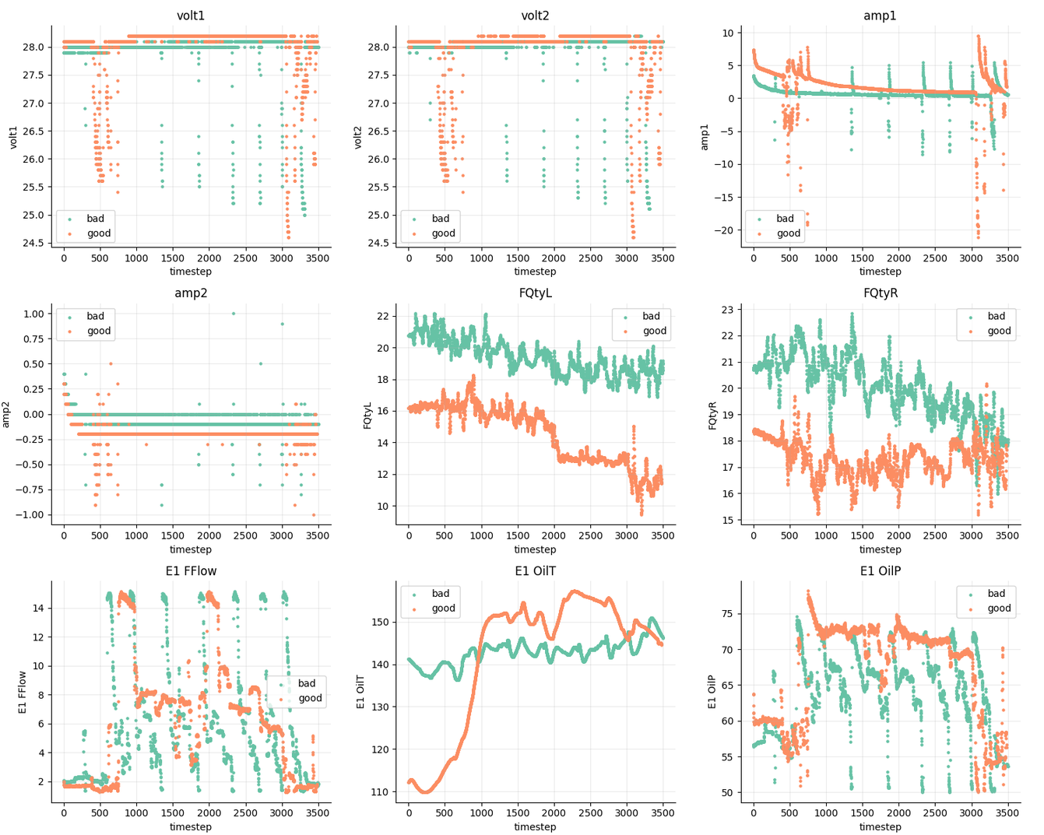
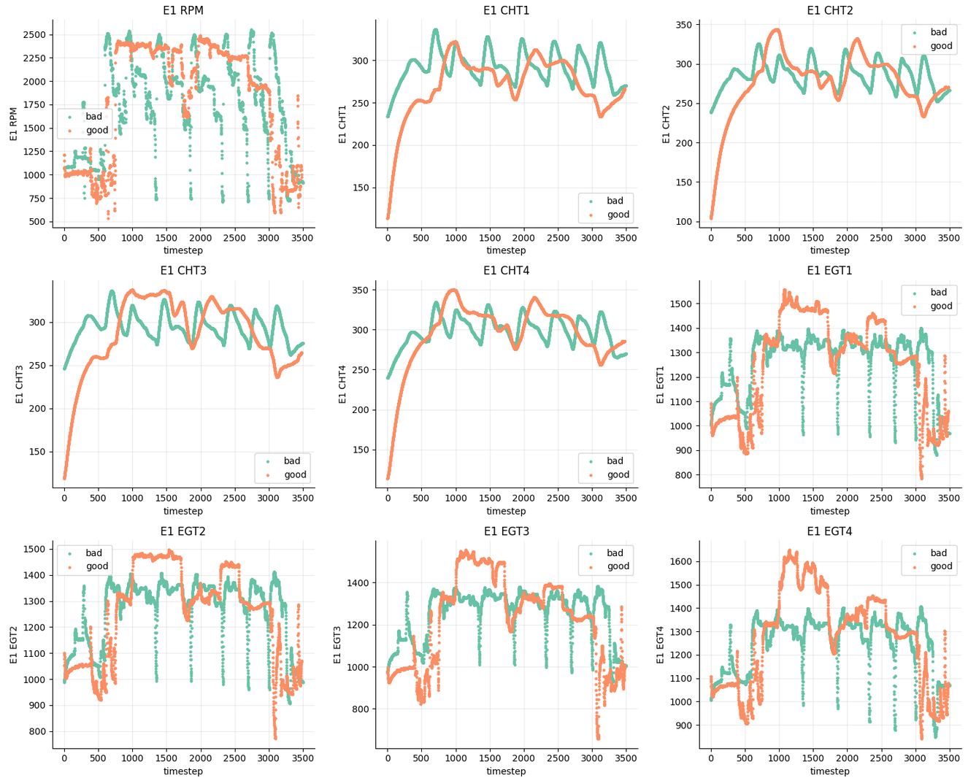
Sample Data

Slide 21
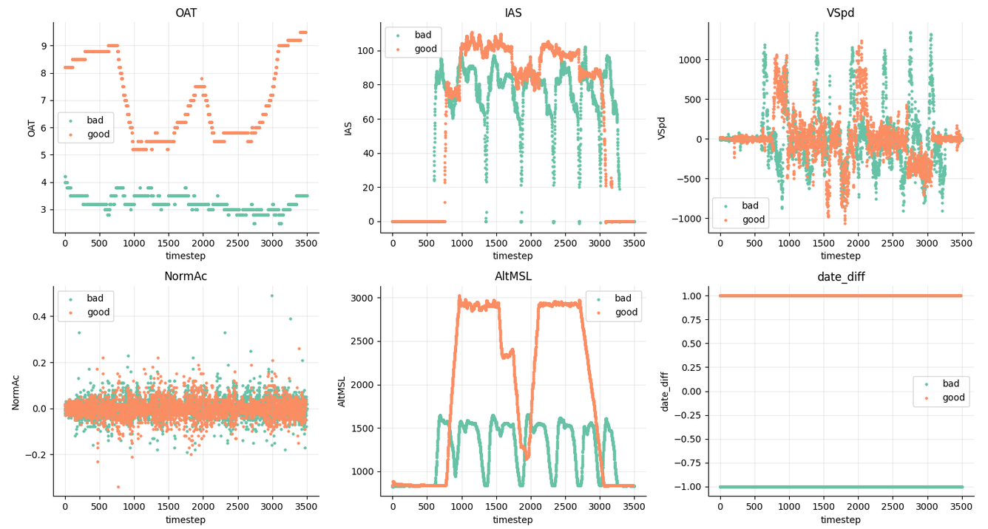
Sample Data

Slide 22
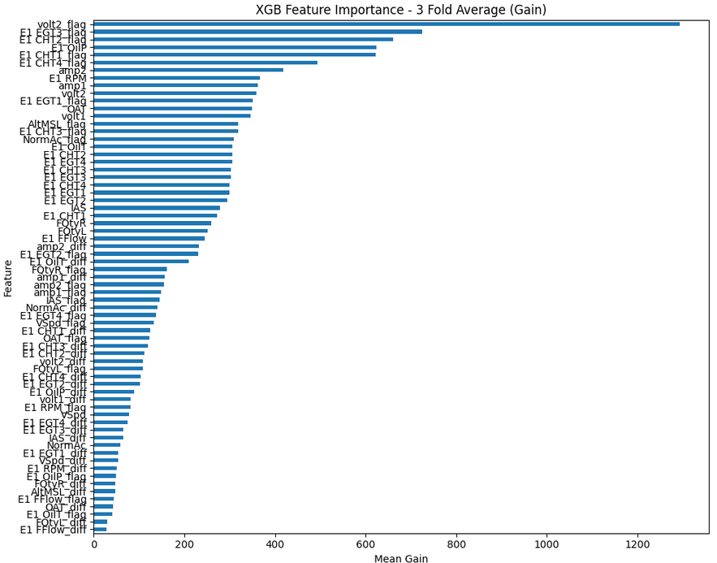
XGB Feature Importance (Full)
Notes:
NGAFID
The NGAFID is part of Aviation Safety Information Analysis and Sharing (ASIAS), a Federal Aviation Administration (FAA) funded, joint government-industry, collaborative information sharing program to proactively analyze broad and extensive data sources towards the advancement of safety initiatives and the discovery of vulnerabilities in the National Airspace System (NAS). The primary objective of ASIAS is to provide a national resource for use in discovering common, systemic safety problems that span multiple operators, fleets, and regions of the airspace. Safety information discovered through ASIAS activities is used across the aviation industry to drive improvements and support a variety of safety initiatives. The NGAFID was originally conceived to bring voluntary Flight Data Monitoring (FDM) capabilities to General Aviation, but has now expanded to include the broader aviation community.

